Slide 1

Comparison of 2015 and 2022 Questionnaire Responses

Slide 2

Number of responses
2015 | 2022
100 household responses covering 226 people | 107 household responses covering 224 people

Slide 3
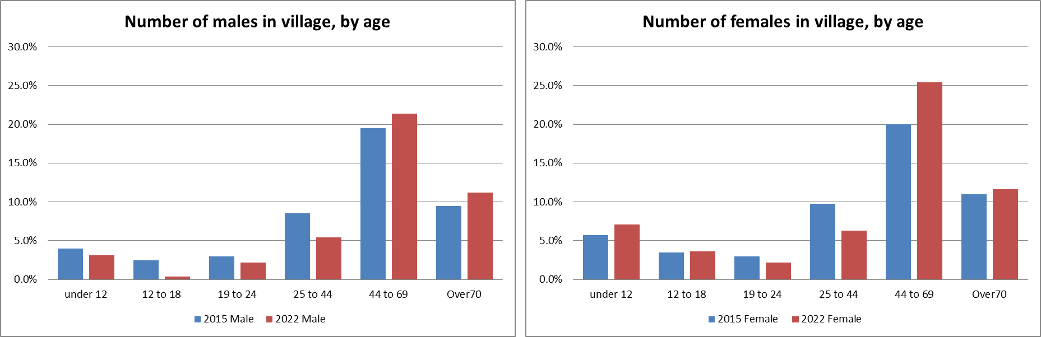
Comparison of who lives in the village?
(% of respondents)

Slide 4
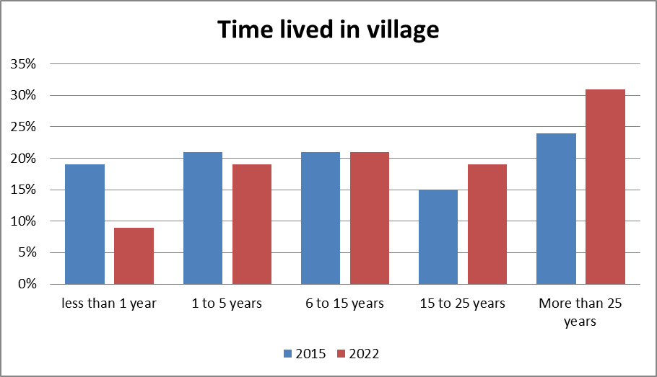
Comparison of how long people have lived in the village?

Slide 5
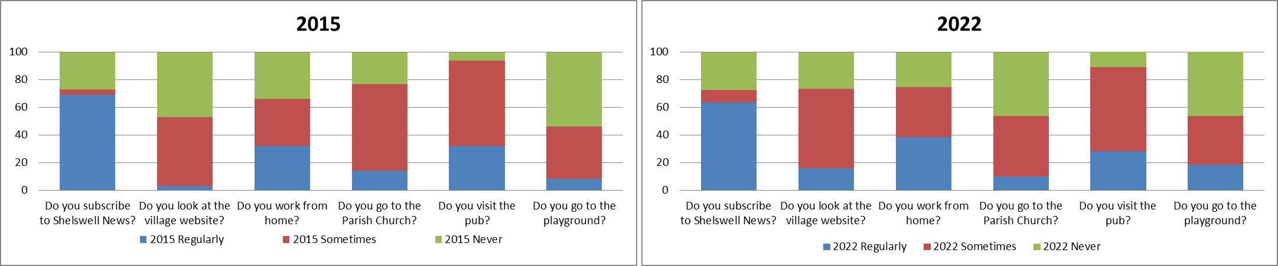
% Comparison of local facilities used:
%
%
Data as a percentage of responses:

Slide 6
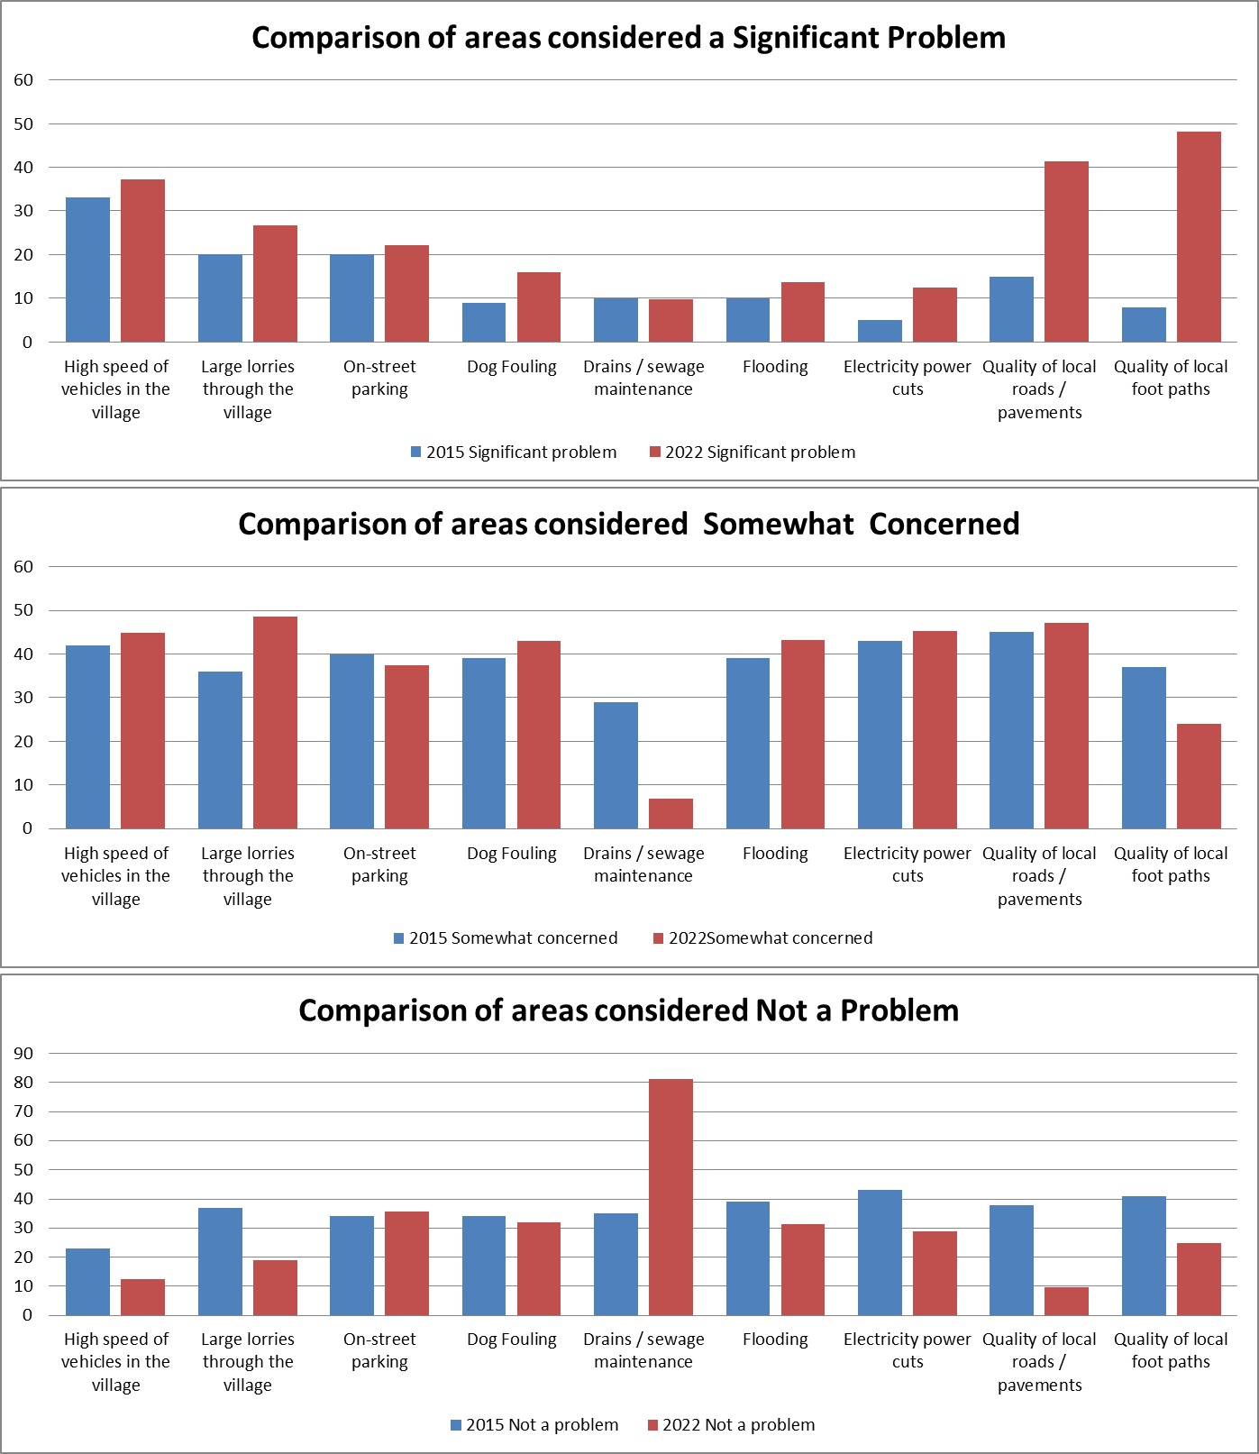
Comparison of areas of concern:
(% of respondents)

