Slide 1

Questionnaire analysis

Slide 2

102 responses
Over 50% of households
Thank You!
Initial analysis on following slides

Slide 3
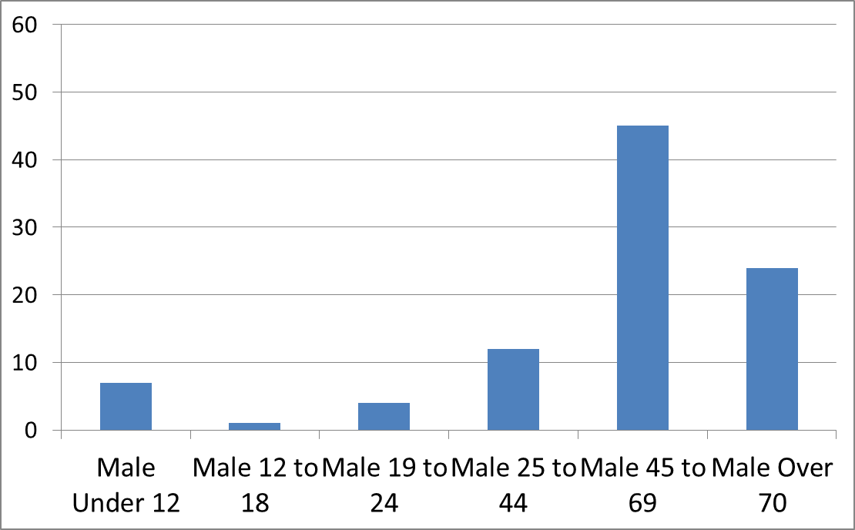
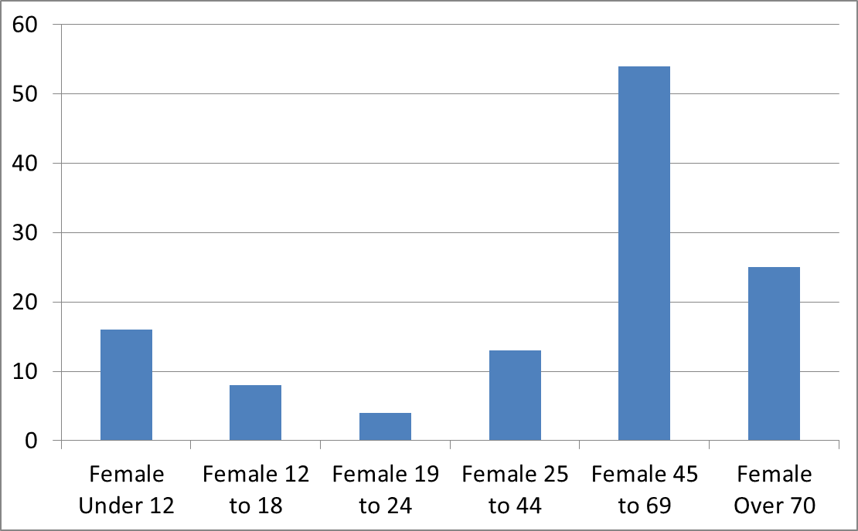
Q1: Who lives in the village?
Number of males in village, by age
Number of females in village, by age

Slide 4
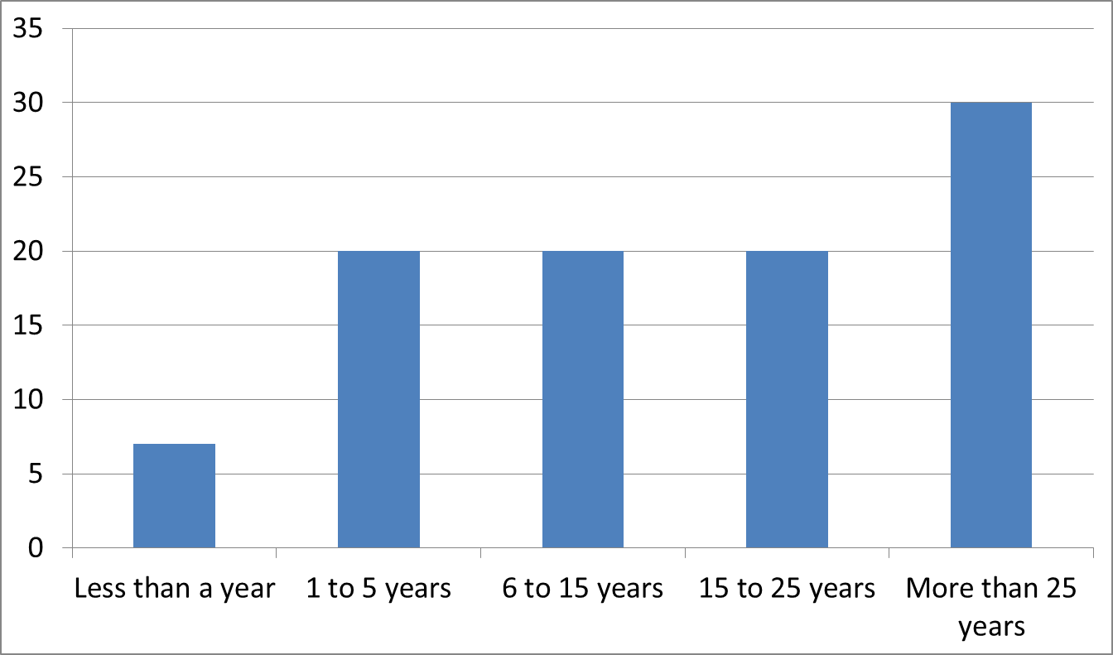
Q2: How long have people lived in the village?
Number of households

Slide 5
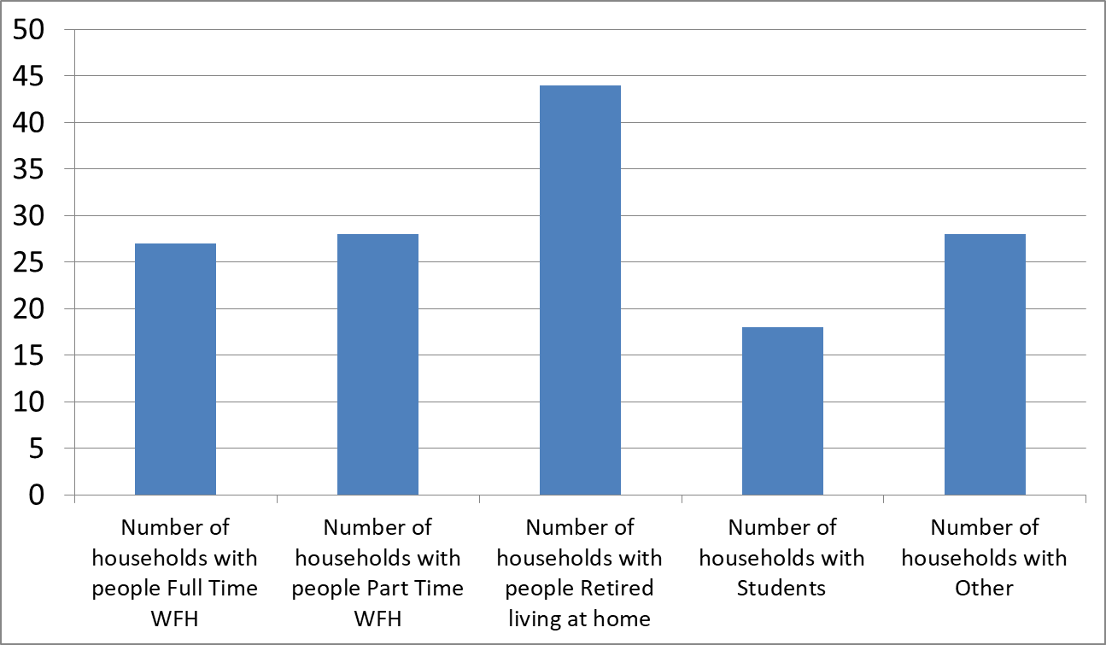
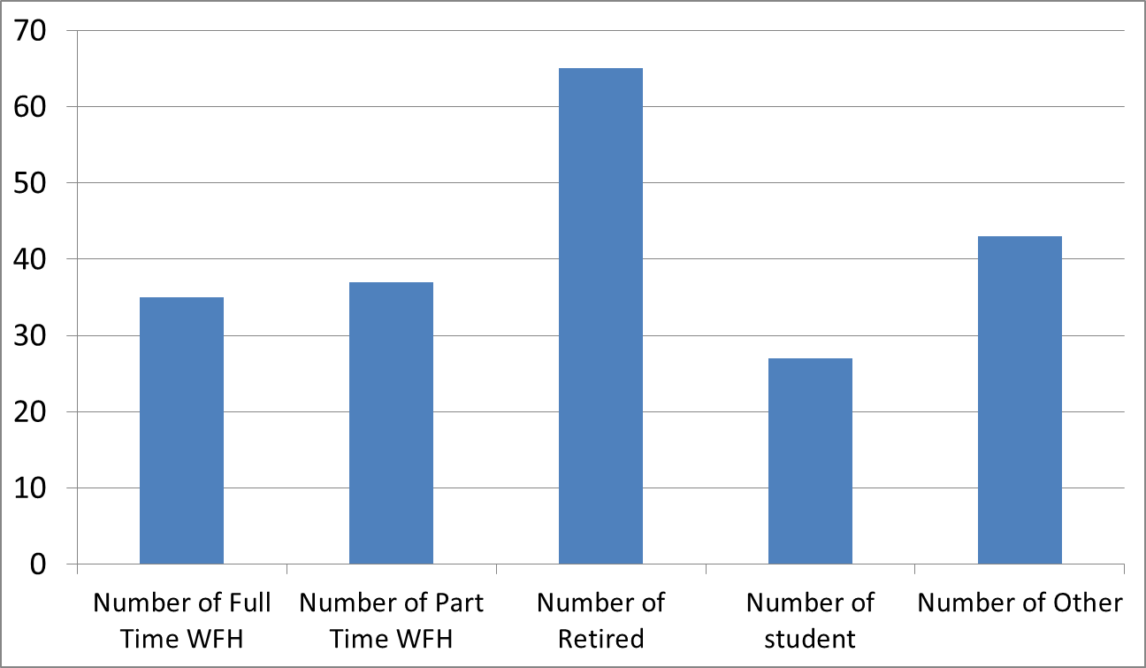
Q3: Who lives in the village?
Number of households working from home, retired, student, other
Number of people identified as working from home, retired, student, other
Interpretation: Often more than 1 person in each category, per household.
Number of retired aligns with age distribution.

Slide 6
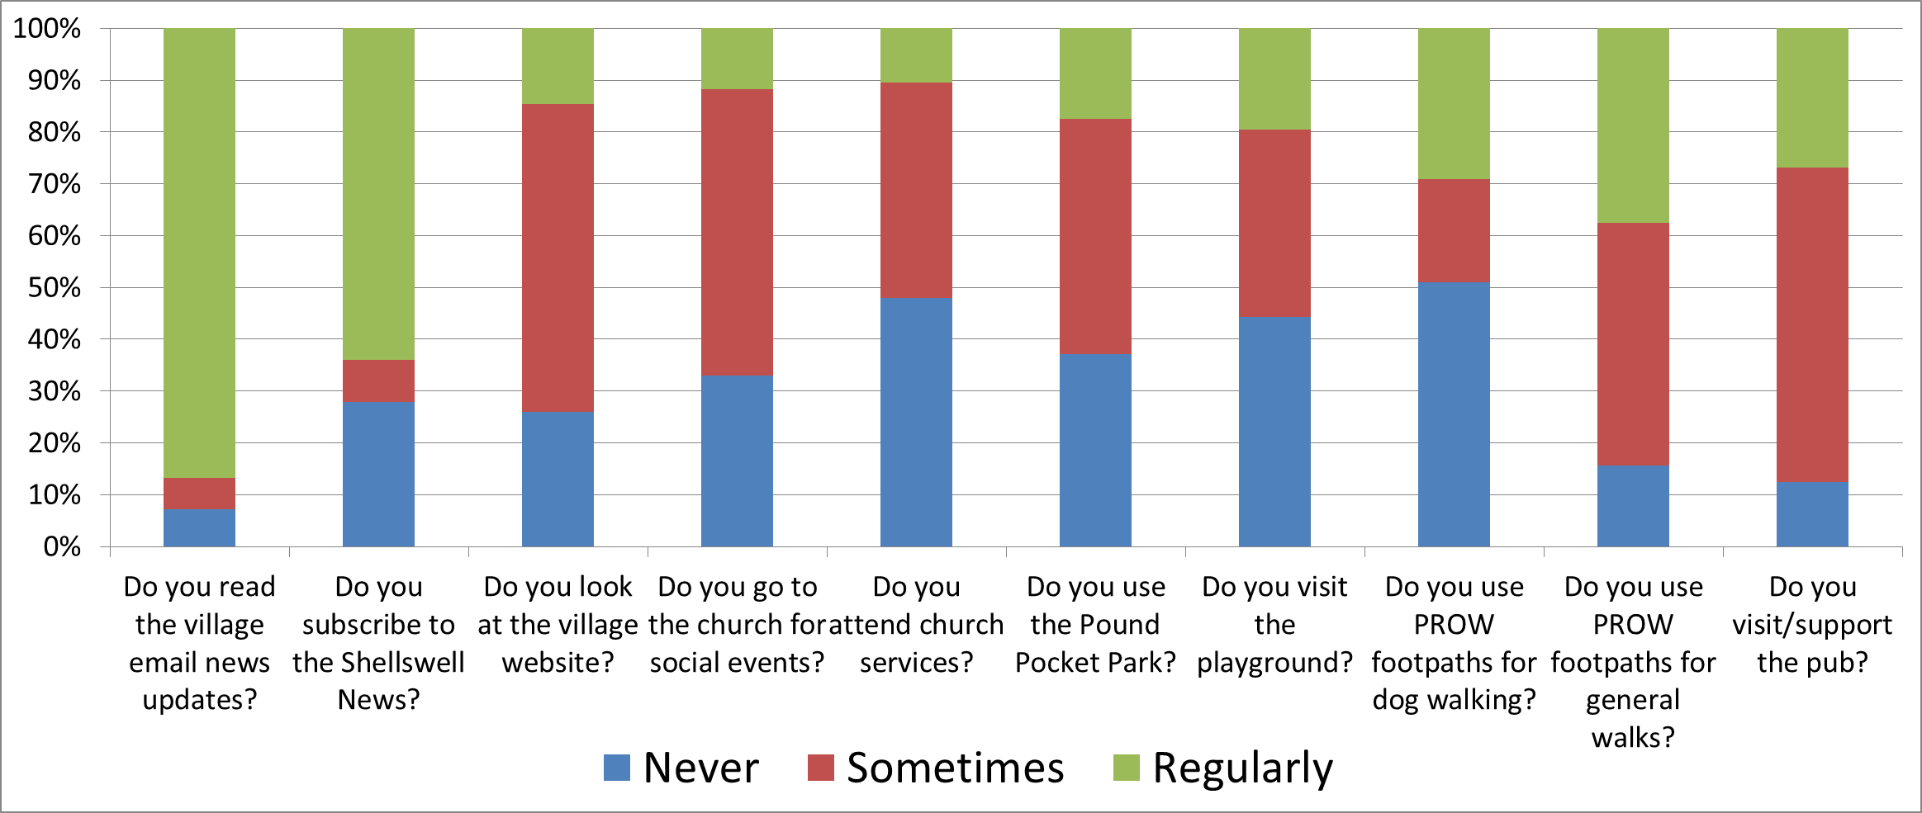
Q4: Local facilities used:

Slide 7
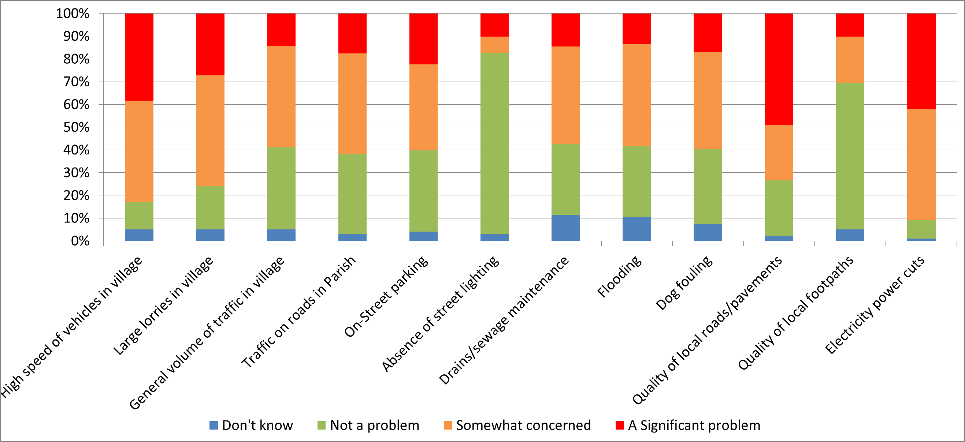
Q5: Your views on the following:

Slide 8
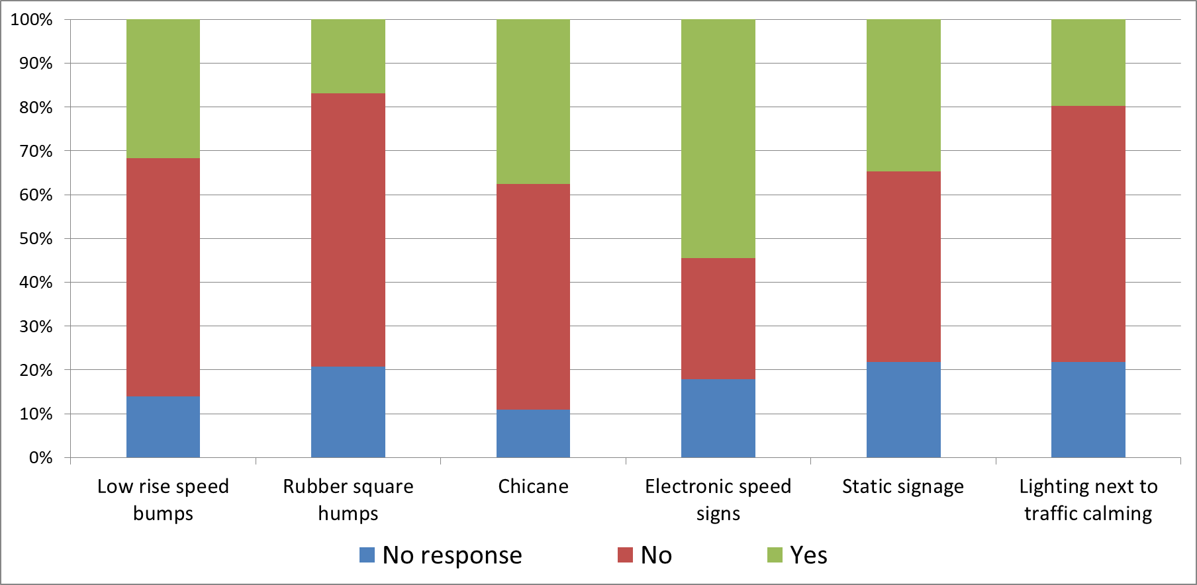
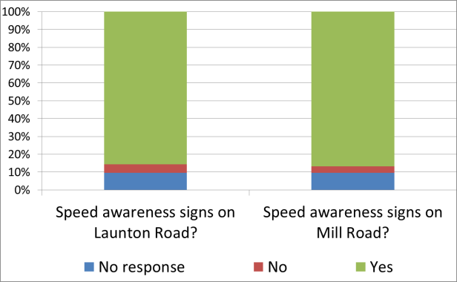
Q11 & 8: Measures to address speeding
Interpretation: Opposition to most physical measures and lighting
Support for electronic speed signage on Launton and Mill roads.

Slide 9
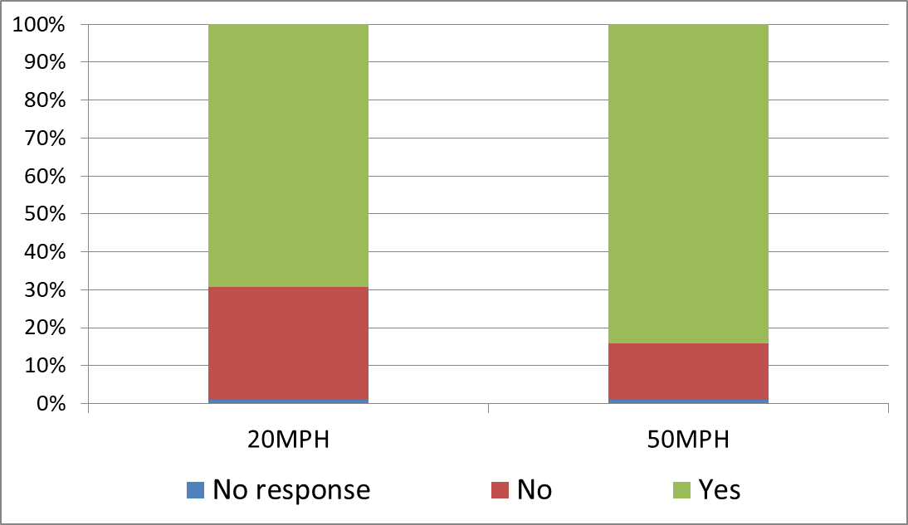
Q12 & 13: 20mph and 50mph limits
Notes: Speed data being collected. Initial data corrupted
We will analyse and share the data when available

Slide 10
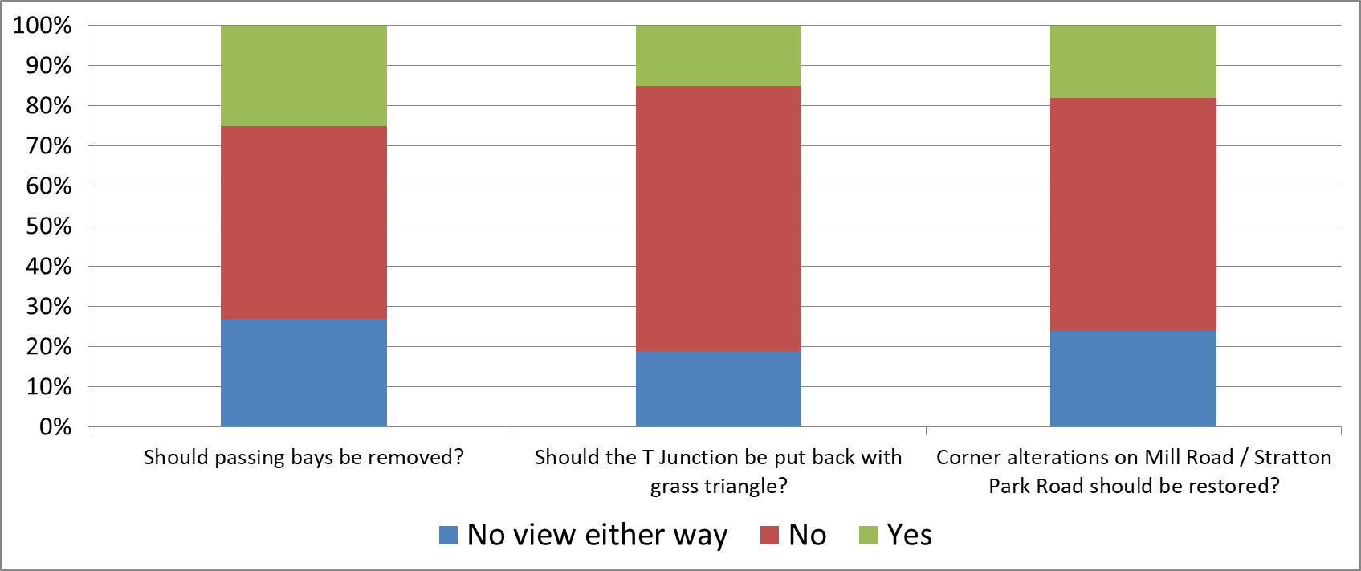
Q15 to 17: EWR commitments

Slide 11

Q6: What is good or that you like?
Interpretation notes:
Community spirit, friendly village
Quiet, peaceful
No street lights
Well kept
The Pub and The Barn
And the Parish Council!

Slide 12
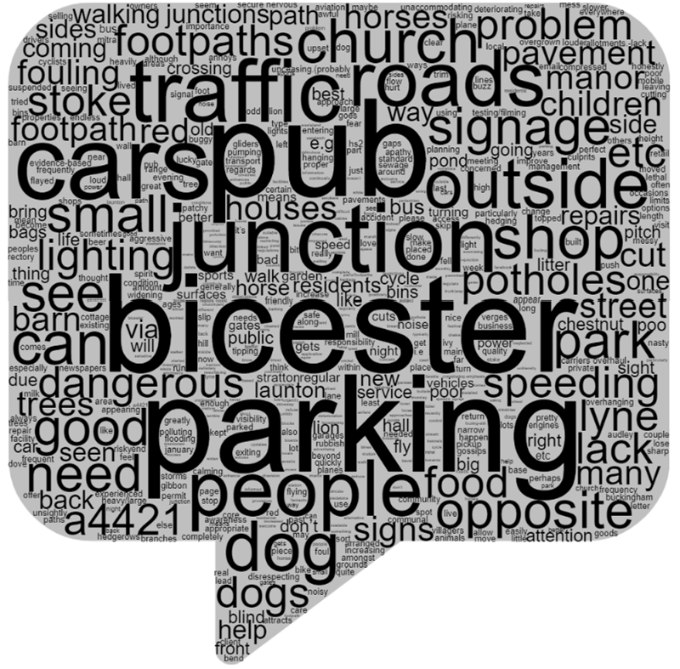
Q7: What is not so good or could be improved?
Interpretation notes:
Bicester Motion, public transport and cycle routes to Bicester & speeding on Bicester Road
Road surfaces, footpaths
Parking outside pub, opposite Bicester Road junction and by the church.
Dog fouling, dogs off-lead and noise.
Traffic and speeding

